Slide 1
Car Dheko - Used Car Price Prediction
Notes:
This presentation was automatically generated by PowerPoint Copilot based on content found in this document: https://ltimindtree-my.sharepoint.com/personal/harikrishnan_10732370_ltimindtree_com/_layouts/15/Doc.aspx?sourcedoc=%7B10286A99-1F22-4E7E-A93B-8AACE0462B9B%7D&file=Car%20Dheko%20-%20Used%20Car%20Price%20Prediction.docx&action=default&mobileredirect=true&DefaultItemOpen=1 AI-generated content may be incorrect.

Slide 2
Project Scope
Project Overview
Historical data on used car prices from CarDekho
Features include make, model, year, fuel type, transmission type, and other attributes
Data Scientist Task
Develop a machine learning model to predict used car prices
Model should be accurate and reliable
Integration
Integrate the model into a Streamlit-based web application
Allow users to input car details and receive an estimated price instantly
Notes:
We have historical data on used car prices from CarDekho. Your task is to develop a machine learning model to predict prices based on various features. This model should be integrated into a Streamlit web application for instant price estimation. Original Content: Project Scope: We have historical data on used car prices from CarDekho, including various features such as make, model, year, fuel type, transmission type, and other relevant attributes from different cities. Your task as a data scientist is to develop a machine learning model that can accurately predict the prices of used cars based on these features. The model should be integrated into a Streamlit-based web application to allow users to input car details and receive an estimated price instantly.

Slide 3

Import and Concatenate
Import and Concatenate
Import all city datasets in unstructured format
Convert datasets into structured format
Concatenate all datasets into a single dataset
Notes:
The data processing steps include importing all city datasets, converting them into a structured format, adding a 'City' column, and concatenating all datasets into one. Original Content: 1) Data Processing a) Import and concatenate: i) Import all city’s dataset which is in unstructured format. ii) Convert it into a structured format. iii) Add a new column named ‘City’ and assign values for all rows with the name of the respective city. iv) Concatenate all datasets and make it as a single dataset.

Slide 4
Handling Missing Values
Identify and Address Missing Values
Detect missing values in the dataset
Decide whether to fill or remove missing values
Techniques for Numerical Columns
Mean imputation: Replace missing values with the mean of the column
Median imputation: Use the median value for replacement
Mode imputation: Fill missing values with the mode of the column
Techniques for Categorical Columns
Mode imputation: Replace missing values with the most frequent category
Create a new category for missing values
Notes:
To handle missing values in datasets, first identify and decide whether to fill or remove them. For numerical columns, use mean, median, or mode imputation. For categorical columns, use mode imputation or create a new category. Original Content: b) Handling Missing Values: Identify and fill or remove missing values in the dataset. i) For numerical columns, use techniques like mean, median, or mode imputation. ii) For categorical columns, use mode imputation or create a new category for missing values.

Slide 5
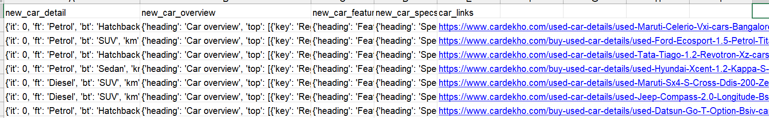
Input Dataset

Slide 6
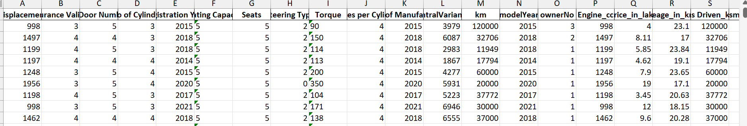
Output Dataset

Slide 7

Model Comparison
Model Comparison
Evaluate different models
Select the best performing model
Notes:
We will compare different models based on evaluation metrics to select the best performing one. Original Content: b) Model Comparison: Compare different models based on evaluation metrics to select the best performing model.

Slide 8
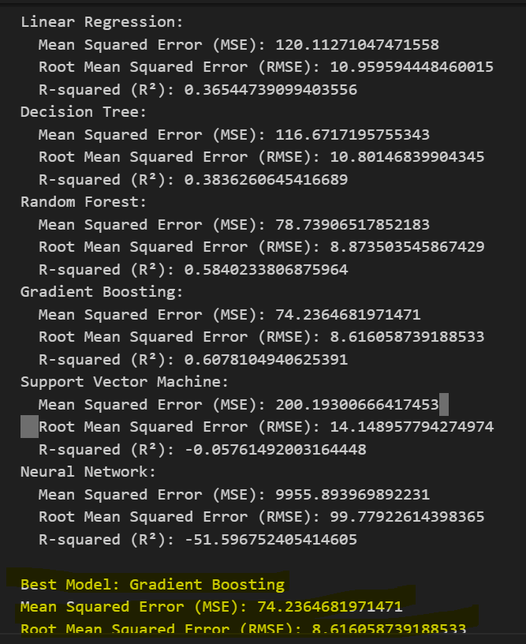

Slide 9
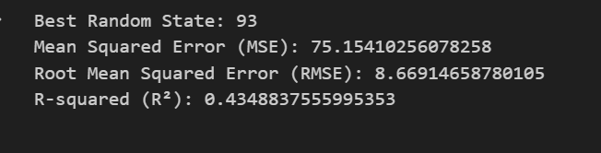
Find Suitable Randomstate value

Slide 10
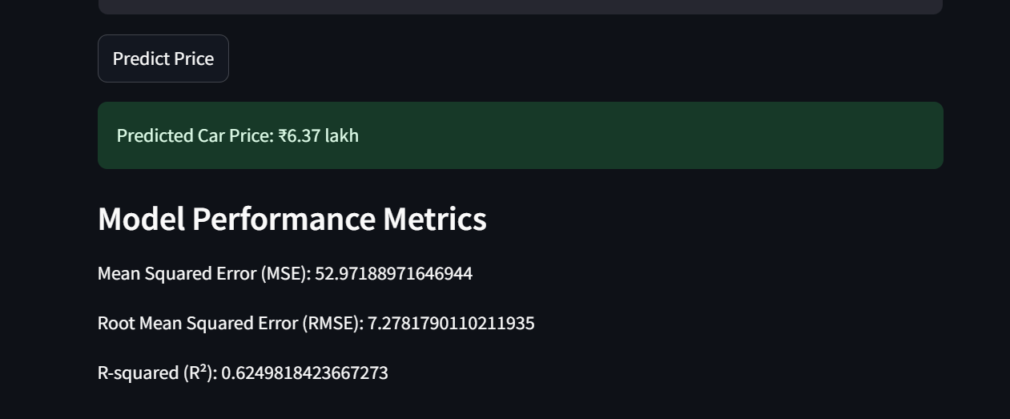
Final output

